Slide 1
Parallel Debugging Techniques
& Introduction to Totalview
Le Yan
Louisiana Optical Network Initiative

Slide 2
Outline
Overview of parallel debugging
  Challenges
  Tools
  Strategies
Get familiar with TotalView through hands-on exercises

Slide 3
Outline
Overview of parallel debugging
  Challenges
  Tools
  Strategies
Get familiar with TotalView through hands-on exercises

Slide 4
Bugs in Parallel Programming
Parallel programs are prone to the usual bugs found in sequential programs
  Improper pointer usage
  Stepping over array bounds
  Infinite loops
  …
Plus…

Slide 5
Common Types of Bugs in Parallel Programming
Erroneous use of language features
  Mismatched parameters, missing mandatory calls etc.
Defective space decomposition
Incorrect/improper synchronization
Hidden serialization
……
http://www.hpcbugbase.org/index.php/Main_Page

Slide 6
Debugging Essentials
Reproducibility
  Find the scenario where the error is reproducible
Reduction
  Reduce the problem to its essence
Deduction
  Form hypotheses on what the problem might be
Experimentation
  Filter out invalid hypotheses
Terrence Parr, Learn The Essentials of Debugging
http://www.ibm.com/developerworks/web/library/wa-debug.html?ca=dgr-lnxw03Dbug

Slide 7
Challenges in Parallel Debugging
Reproducibility
  Many problems cannot be easily reproduced
Reduction
  Smallest scale might still be too large and complex to handle
Deduction
  Need to consider concurrent and interdependent program instances
Experimentation
  Cyclic debugging might be very expensive

Slide 8
Bugs: A Little Example
…
integer*4 :: i,ista,iend
integer*4 :: chunksize=1024*1024
…
call MPI_Comm_Rank(MPI_COMM_WORLD, &
myrank,error)
…
ista=myrank*chunksize+1
iend=(myrank+1)*chunksize
do i = ista,iend
…
enddo
…
What is the potential problem with large core count?

Slide 9
Bugs: A Little Example
…
integer*4 :: i,ista,iend
integer*4 :: chunksize=1024*1024
…
call MPI_Comm_Rank(MPI_COMM_WORLD, &
myrank,error)
…
ista=myrank*chunksize+1
iend=(myrank+1)*chunksize
do i = ista,iend
…
enddo
…
A bug that shows up only when running with more than 4096 cores
Integer overflow if myrank ≥ 4096

Slide 10
Debugging with write/printf
Very easy to use and most portable, but…
  Need to edit, recompile and rerun when additional information is desired
  May change program behavior
  Only capable of displaying a subset of the program’s state
  Output size grows rapidly with increasing core count and harder to comprehend
Not recommended

Slide 11
Compilers Can Help
Most compilers can (at runtime)
  Check array bounds
  Trap floating operation errors
  Provide traceback information
Relatively scalable, but…
  Overhead added
  Limited capability
  Non-interactive

Slide 12
Parallel Debuggers
Capable of what serials debuggers can do
  Control program execution
  Set action points
  View/edit values of variables
More importantly
  Control program execution at various levels
    Group/process/thread
  Display communication status between processes

Slide 13
An Ideal Parallel Debugger
Should allow easy process/thread control and navigation
Should support multiple high performance computing platforms
Should not limit the number of processes being debugged and should allow it to vary at runtime

Slide 14
How Parallel Debuggers Work
Frontend
  GUI
  Debugger engine
Debugger Agents
  Control application processes
  Send data back to the debugger engine to analyze
User processes
…
Agent
Agent
Agent
Compute nodes
Debugger engine
Interactive node
GUI

Slide 15
Debugging at Very Large Scale
The debugger itself becomes a large parallel application
Bottlenecks
  Debugger framework startup cost
  Communication between frontend and agents
  Access to shared resources, e.g. file system

Slide 16
Validation Is Crucial
Have a solid validation procedure to check the correctness
Test smaller components before putting them together

Slide 17
General Parallel Debugging Strategy
Incremental debugging
  Downscale if possible
    Participating processes, problem size and/or number of iterations
    Example: run with one single thread to detect scope errors in OpenMP programs
  Add more instances to reveal other issues
    Example: run MPI programs on more than one node to detect problems introduced by network delays

Slide 18
Strategy at Large Scale
Again, downscale if possible
Reduce the number of processes to which the debugger is attached
  Reduces overhead
  Reduces the required number of license seats as well
Focus on one or a small number of processes/threads
  Analyze call path and message queues to find problematic processes
  Control the execution of as few processes/threads as possible while keeping others running
    Provides the context where the error occurs

Slide 19
Trends in Debugging Technology
Lightweight trace analysis tools
  Help to identify processes/threads that have similar behavior and reduce the search space
  Complementary to full feature debuggers
  Example: Stack Trace Analysis Tool (STAT)
Replay/Reverse execution
  ReplayEngine now available from TotalView
Post-mortem statistical analysis
  Detect anomalies by analyzing profile dissimilarity of multiple runs

Slide 20
Outline
Overview of parallel debugging
  Challenges
  Tools
  Strategies
Get familiar with TotalView through hands-on exercises

Slide 21
What Is TotalView
A powerful debugger for both serial and parallel programs
  Support Fortran, C/C++ and Assembler
  Supported on most platforms
  Both graphic and command line interface
Features
  Common debugging functions such as execution control and breakpoints
  Memory debugging
  Reverse debugging
  Batch mode debugging
  Remote debugging client
  …

Slide 22
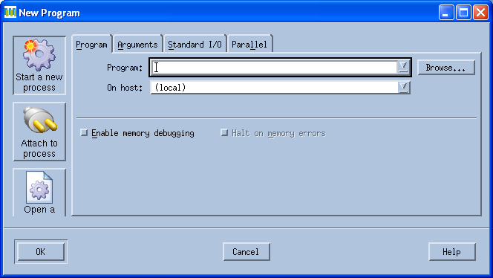
Three Ways to Start TotalView
Start with core dumps
Start by attaching to one or more running processes
Start the executable within TotalView

Slide 23
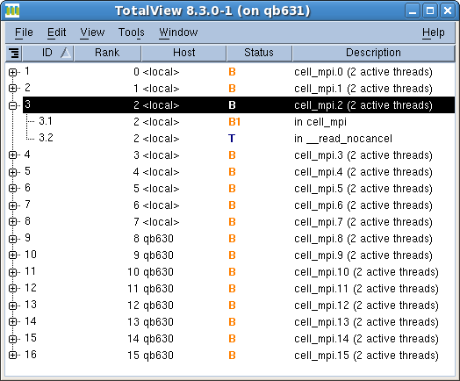
User Interface - Root Window
Host name
Status
Status Code | Description
Blank | Exited
B | At breakpoint
E | Error
H | Held
K | In kernel
M | Mixed
R | Running
T | Stopped
W | At watchpoint
TotalView ID
MPI Rank

Slide 24
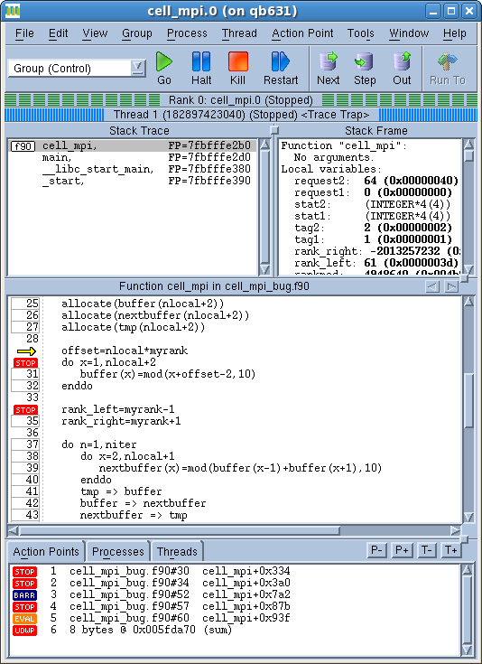
User Interface – Process Window
Stack trace pane
  Call stack of routines
Stack frame pane
  Local variables, registers and function parameters
Source pane
  Source code
Action points, processes, threads pane
  Manage action points, processes and threads

Slide 25

Control Commands
TotalView | Description
Go | Start/resume execution
Halt | Stop execution
Kill | Terminate the job
Restart | Restarts a running program
Next | Run to the next source line without stepping into another function
Step | Run to next source line
Out | Run to the completion of current function
Run to | Run to the indicated location

Slide 26
Controlling Execution
The process window always focuses on one process/thread
Switch between processes/threads
  p+/p-, t+/t-, double click in root window, process/thread tab
Need to set the appropriate scope when
  Giving control commands
  Setting action points

Slide 27
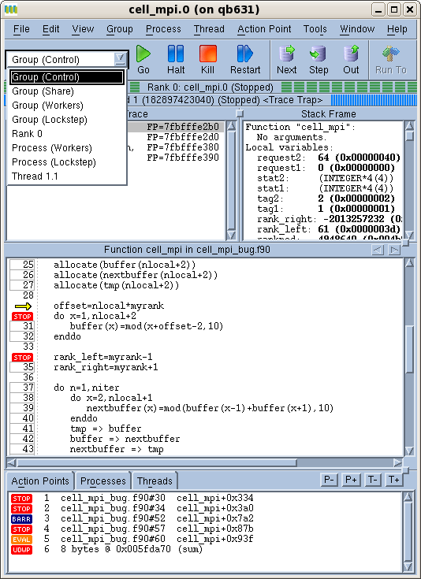
Process/Thread Groups
Scope of commands and action points
  Group(control)
    All processes and threads
  Group(workers)
    All threads that are executing user code
  Rank X
    Current process and its threads
  Process(workers)
    User threads in the current process
  Thread X.Y
    Current thread
  User defined group
    Group -> Custom Groups, or
    Create in call graph

Slide 28
Types of Action Points
Breakpoints stop the execution of the processes and threads that reach it
Evaluation points: stop and execute a code fragment when reached
  Useful when testing small patches
Process barrier points synchronize a set of processes or threads
Watchpoints monitor a location in memory and stop execution when its value changes
  Unconditional
  Conditional

Slide 29
Setting Action Points
Breakpoints
  Right click on a source line -> Set breakpoint
  Click on the line number
Watch points
  Right click on a variable -> Create watchpoint
Barrier points
  Right click on a source line -> Set barrier
Edit action point property
  Right click on a action point in the Action Points tab -> Properties

Slide 30
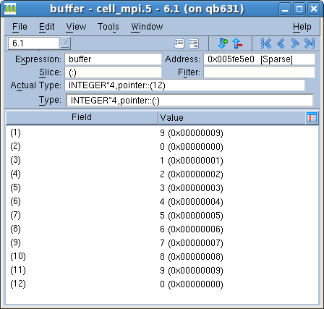
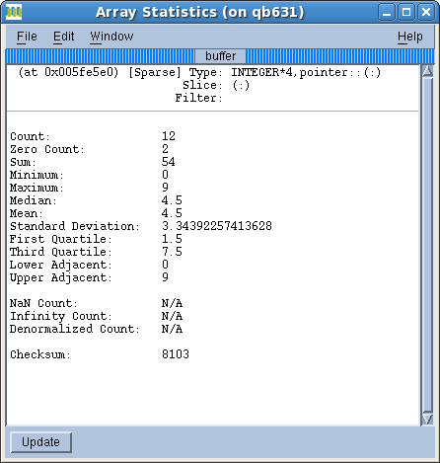
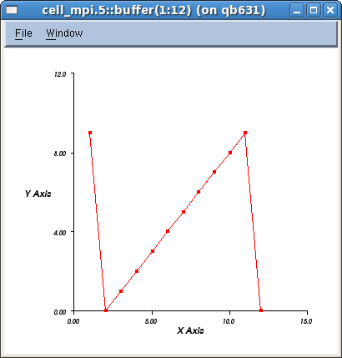
Viewing/Editing Data
View values and types of variables
  At one process/thread
  Across all processes/threads
Edit variable value and type
Array Data
  Slicing
  Filtering
  Visualization
  Statistics

Slide 31
Viewing Dynamic Arrays in C/C++
Edit “type” in the variable window
Tell TotalView how to access the memory from a starting location
Example
  To view an array of 100 integers
    Change “Int *” to “int[100]*”

Slide 32
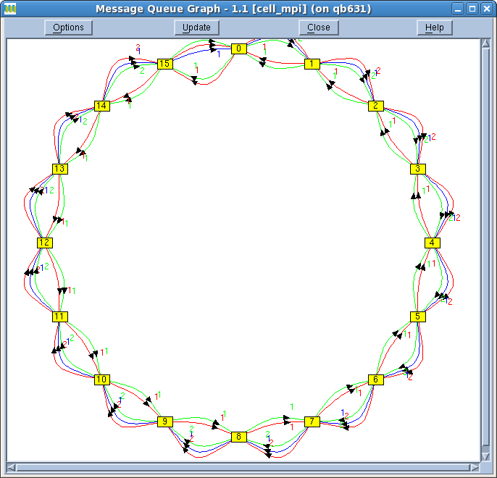
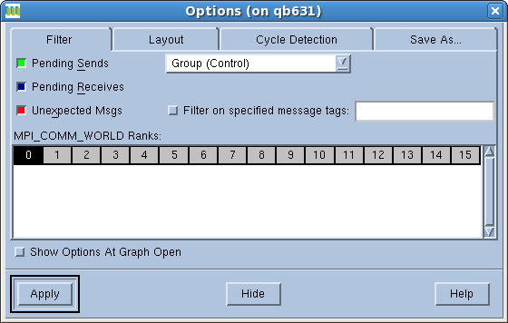
MPI Message Queues
Detect
  Deadlocks
  Load balancing issues
Tools -> Message Queue Graph
  More options available

Slide 33
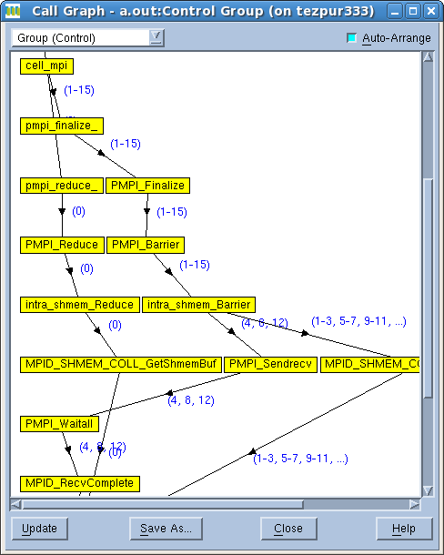
Call Graph
Tools -> Call graph
Quick view of program state
  Nodes: functions
  Edges: calls
Look for outliers

Slide 34
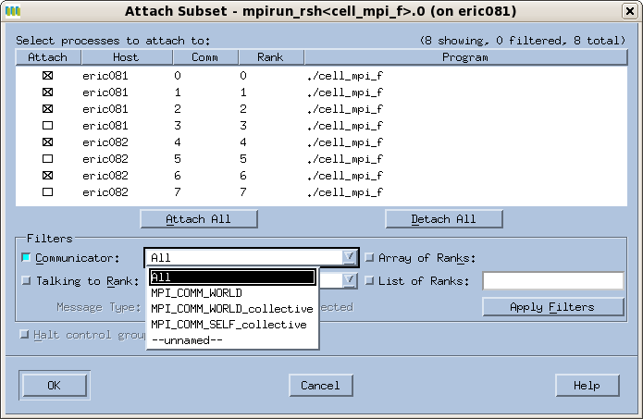
Attaching to/Detaching from Processes
You can
  Attach to one or more running processes after launching TotalView
  Launch the program within TotalView and detach from/reattach to any subset of processes later on

Slide 35
Memory Debugging
Features
  Memory usage report
  Error detection
    Memory leak
    Dangling pointer
    Memory corruption
  Event notification
    Deallocation/reallocation
  Memory comparison between processes

Slide 36
Memory Debugging - Usage
Need to link to the TotalView heap library to monitor heap status
  The name of the library is platform dependent
To access memory debugging functions
  Prior to 8.7
    Tools -> Memory debugging
  Since 8.7
    Debug -> Open MemoryScape

Slide 37
References
TotalView user manual
  http://www.totalviewtech.com/support/documentation/totalview/index.html
LLNL TotalView tutorial
  https://computing.llnl.gov/tutorials/totalview
NCSA Cyberinfrastructure Tutor
  “Debugging Serial and Parallel Codes” course
HPCBugBase
  http://hpcbugbase.org/index.php/Main_Page

Slide 38
Hands-on Exercise
Debug MPI and OpenMP programs that solve a simple problem to get familiar with
  Basic functionalities of parallel debuggers
    TotalView: BigRed, Kraken, Steele and Queen Bee
    DDT: BigRed, Kraken, Ranger and Lonestar
  Some common types of bugs in parallel programming
Programs and instructions can be found at http://www.cct.lsu.edu/~lyan1/summerschool10

Slide 39
Problem
0 | 1 | 2 | 3 | 4 | 5 | 6 | 7 | 8 | … | 4 | 5
A 1-D periodic array with N elements
Initial value
  C: cell(x)=x%10
  Fortran: cell(x)=mod(x-1,10)
In each iteration, all elements are updated with the value of two adjacent elements:
  cell(x)i+1=[cell(x-1)i+cell(x+1)i]%10
Execute Niter iterations
The final outputs are the global maximum and average
http://www.hpcbugbase.org/index.php/Main_Page

Slide 40
Sequential Program
Use an integer array to hold current values
Use another integer array to hold the calculated values
Swap the pointers at the end of each iteration
The result is used to check the correctness of the parallel programs
  Chances are that we will not have such a luxury for large jobs

Slide 41
MPI Program
0 | 1 | 2 | 3 | 4 | 5 | 6 | 7 | 8 | … | 4 | 5
5 | 0 | 1 | 2 | … | 5 | 6
5 | 6 | 7 | 8 | … | 2 | 3
……
7 | 8 | 9 | 0 | … | 5 | 0
Process 1
Process 2
Process n
Divide the array among n processes
Each process works on its local array
Exchange boundary data with neighbor processes at the end of each iteration
Ring topology

Slide 42
OpenMP Program
0 | 1 | 2 | 3 | 4 | 5 | 6 | 7 | 8 | … | 4 | 5
Thread 0
Thread 1 …
Thread n
Each thread works on its own part of the global array
All threads have access to the entire array, so no data exchange is necessary

