Slide 1
Hadoop MapReduce
Stephen
Tak-Lon Wu
Indiana University
Some material adapted from slides by Christophe Bisciglia, Aaron Kimball, & Sierra Michels-Slettvet, Google Distributed Computing Seminar, 2007 (licensed under Creation Commons Attribution 3.0 License)

Slide 2
Outline
MapReduce Overview
Hadoop-WordCount Demo
Hadoop-Blast Demo
Q&A

Slide 3
MapReduce in Simple Terms
Mapreduce – The Story of Tom
    By Saliya Ekanayake

Slide 4
Mapeduce in Functional Programming
Map
  Apply the same function f to all the elements of a list
Fold
  Moves across a list, applying function g to each element plus an accumulator.
f
f
f
f
f
Map
Fold
g
g
g
g
g
initial
Result

Slide 5
MapReduce Programming Model
influenced by Functional Programming constructs
Users implement interface of two functions:
  map (in_key, in_value) ->
  (out_key, intermediate_value) list
  reduce (out_key, intermediate_value list) ->
  out_value list
Source: http://code.google.com/edu/parallel/mapreduce-tutorial.html

Slide 6
Map
A list of data elements are passed, one at a time, to map() functions which transform each data element to an individual output data element.
A map() produces one or more intermediate <key, values> pair(s) from the input list.
…
…
Input list
k1
V1
k2
V2
k3
V3
k4
V4
k5
V5
k6
V6
MAP
MAP
MAP
MAP
Intermediate
output list
…
…
k’1
V’1
k’2
V’2
k’3
V’3
k’4
V’4
k’5
V’5
k’6
V’6

Slide 7
Reduce
After map phase finish, those intermediate values with same output key are reduced into one or more final values
Intermediate
map output
…
…
k’1
V’1
k’2
V’2
k’3
V’3
k’4
V’4
k’5
V’5
k’6
V’6
Reduce
Reduce
Reduce
Final Result
…
…
F1
R1
F2
R2
F3
R3

Slide 8
Parallelism
map() functions run in parallel, creating different intermediate values from different input data elements
reduce() functions also run in parallel, working with assigned output key
All values are processed independently
Reduce phase can’t start until map phase is completely finished.
Source: http://code.google.com/edu/parallel/mapreduce-tutorial.html

Slide 9
Apache Hadoop
Open Source MapReduce framework implementation
Widely used by
  Amazon Elastic MapReduce
  EBay
  FaceBook
  TeraSort in Yahoo!
  …
Active community
Many sub projects
  HDFS
  Pig Latin
  Hbase
  …
Source: http://wiki.apache.org/hadoop/PoweredBy

Slide 10
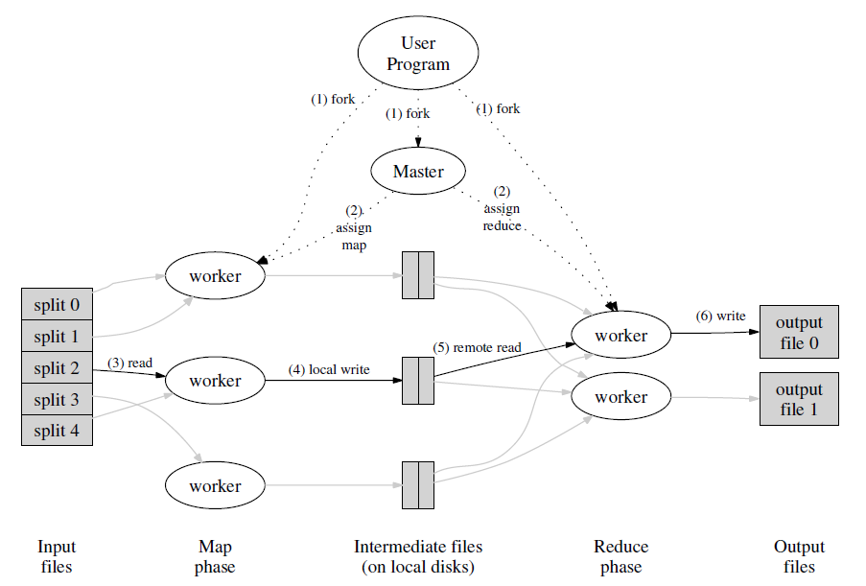
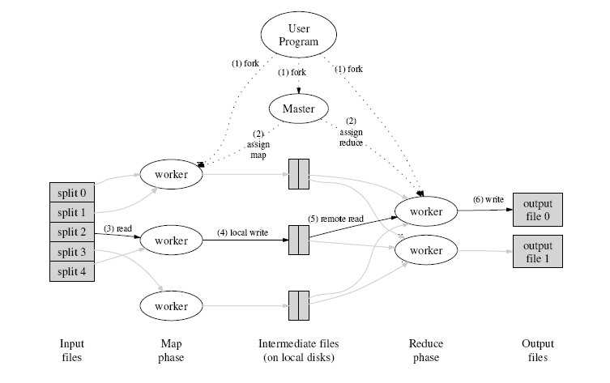
Execution Overview
Source: http://code.google.com/edu/parallel/mapreduce-tutorial.html
Notes:
The MapReduce library in the user program first shards the input files into M pieces of typically 16 megabytes to 64 megabytes (MB) per piece. It then starts up many copies of the program on a cluster of machines.
One of the copies of the program is special: the master. The rest are workers that are assigned work by the master. There are M map tasks and R reduce tasks to assign. The master picks idle workers and assigns each one a map task or a reduce task.
A worker who is assigned a map task reads the contents of the corresponding input shard. It parses key/value pairs out of the input data and passes each pair to the user-defined Map function. The intermediate key/value pairs produced by the Map function are buffered in memory.
Periodically, the buffered pairs are written to local disk, partitioned into R regions by the partitioning function. The locations of these buffered pairs on the local disk are passed back to the master, who is responsible for forwarding these locations to the reduce workers.
When a reduce worker is notified by the master about these locations, it uses remote procedure calls to read the buffered data from the local disks of the map workers. When a reduce worker has read all intermediate data, it sorts it by the intermediate keys so that all occurrences of the same key are grouped together. If the amount of intermediate data is too large to fit in memory, an external sort is used.
The reduce worker iterates over the sorted intermediate data and for each unique intermediate key encountered, it passes the key and the corresponding set of intermediate values to the user's Reduce function. The output of the Reduce function is appended to a final output file for this reduce partition.
When all map tasks and reduce tasks have been completed, the master wakes up the user program. At this point, the MapReduce call in the user program returns back to the user code.

Slide 11
MapReduce in Apache Hadoop
Autoparallelization
data distribution
Fault-tolerant
Status monitoring
Simple programming constructs

Slide 12
Demo 1 - WordCount
“Hello World” in MapReduce programming style
Fits well with the MapReduce programming model
  count occurrence of each word in given files
  each file (may be split) run in parallel
  need reduce phase to collect final result
Three main parts:
  Mapper
  Reducer
  Driver

Slide 13
Word Count
Input
Mapping
Shuffling
Reducing
foo, 1
car, 1
bar, 1
foo, 1
foo, 1
foo, 1
foo, 3
foo car bar
foo bar foo
car car car
foo, 1
bar, 1
foo, 1
bar, 1
bar, 1
bar, 2
car, 1
car, 1
car, 1
car, 1
car, 1
car, 1
car,1
car, 4
Notes:
Represent the resulting data products.

Slide 14
WordCount Map
void Map (key, value) {
for each word x in value:
output.collect(x, 1);
}

Slide 15
WordCount Map
public static class Map
extends Mapper<LongWritable, Text, Text, IntWritable>{
private final static IntWritable one = new IntWritable(1);
private Text word = new Text();
public void map(LongWritable key, Text value, Context context ) throws IOException, InterruptedException {
StringTokenizer itr = new StringTokenizer(value.toString());
while (itr.hasMoreTokens()) {
word.set(itr.nextToken());
context.write(word, one);
}
}
}

Slide 16
WordCount Reduce
void Reduce (keyword, <list of value>){
for each x in <list of value>:
sum+=x;
output.collect(keyword, sum);
}

Slide 17
WordCount Reduce
public static class Reduce
extends Reducer<Text,IntWritable,Text,IntWritable> {
private IntWritable result = new IntWritable();
public void reduce(Text key, Iterable<IntWritable> values, Context context) throws …..{
int sum = 0; // initialize the sum for each keyword
for (IntWritable val : values) {
sum += val.get();
}
result.set(sum);
context.write(key, result);
}
}

Slide 18
Log in to FutureGrid
qsub –I
  Get a FutureGrid Work node
hostname
  e.g. i51
  Public hostname name should be
    i51r.idp.iu.futuregrid.org
    http://salsahpc.indiana.edu/tutorial/futuregrid_access.html

Slide 19
Building WordCount program
cd Hadoop-WordCount
cat WordCount.java
cat build.sh
./build.sh
ls -l

Slide 20
Running WordCount using Hadoop standalone
cd ~/hadoop-0.20.2-standalone/bin
cp ~/Hadoop-WordCount/wordcount.jar ~/hadoop-0.20.2-standalone/bin
./hadoop jar wordcount.jar WordCount ~/Hadoop-WordCount/input ~/Hadoop-WordCount/output
    Simulate HDFS using the local directories
cd ~/Hadoop-WordCount/
cat output/part-r-00000
Notes:
Very useful for development debugging.

Slide 21
Optimizations
Reduce phase can only be activated until all map tasks finish
  It will be a waste if there is a extremely long map task
“Combiner” functions can run on same machine as a mapper
Causes a mini-reduce phase to occur before the real reduce phase, to save bandwidth

Slide 22
Word Count with Combiner
Input
Mapping
Combiner
Shuffling
Reducing
foo, 1
car, 1
bar, 1
foo, 1
car, 1
bar, 1
foo, 1
foo, 2
foo, 3
foo car bar
foo bar foo
car car car
foo, 1
bar, 1
foo, 1
foo, 2
bar, 1
bar, 1
bar, 1
bar, 2
car, 1
car, 1
car, 1
car, 3
car, 1
car, 3
car, 4

Slide 23
Terminology
Job
Jobtracker
Task
TaskTracker
Shard

Slide 24
HDFS
Based on Google File System
Run on commodity low-cost hardware
Fault tolerance
  Redundant storage
High throughput access
Suitable for large data sets
Large capacity
Integration with MapReduce

Slide 25
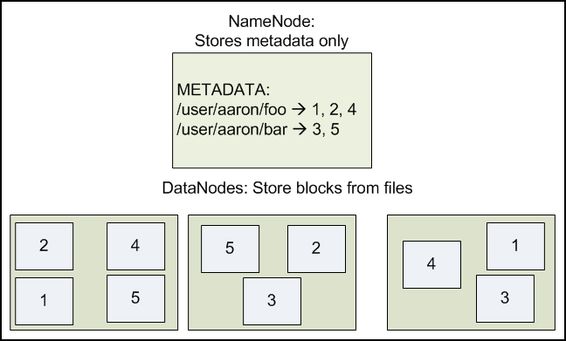
Architecture
Single NameNode
Multiple Data Nodes
Source: http://developer.yahoo.com/hadoop/tutorial/index.html
Notes:
Single point of Failure weekness.

Slide 26
Configuring HDFS
dfs.name.dir
  Dir in the namenode to store metadata
dfs.data.dir
  Dir in data nodes to store the data blocks
  Must be in a local disk partition
conf/hdfs-site.xml
<property>
<name>dfs.name.dir</name>
<value>/tmp/hadoop-test/name</value>
</property>
<property>
<name>dfs.data.dir</name>
<value>/tmp/hadoop-test/data</value>
</property>
Notes:
While we are at it, let’s create a local dir too..

Slide 27
Configuring HDFS
fs.default.name
  URI of the namenode
conf/masters
  ip address of the master node
conf/slaves
  ip address of the slave nodes
Should have password-less SSH access to all the nodes
conf/core-site.xml
<property>
<name>fs.default.name</name>
<value>hdfs://149.79.89.113:9000/</value>
</property>

Slide 28
HDFS Cluster
Starting HDFS
  cd ~/hadoop-0.20.2/bin
  ./hadoop namenode -format
  ./start-dfs.sh
NameNode logs
  cd ~/hadoop-0.20.2
  logs/hadoop-<username>-namenode-<nodeid>.log
Monitoring web interface
  http://<public_ip>:50070

Slide 29
HDFS Commands
./bin/hadoop fs –[command]
  put
  get
  ls
  cp
  mkdir
  rm
http://hadoop.apache.org/common/docs/current/hdfs_shell.html
Programmatic API

Slide 30
Configuring Hadoop MapREduce
mapred.job.tracker
mapred.local.dir
mapred.tasktracker.map.tasks.maximum
conf/mapred-site.xml
<property>
<name>mapred.job.tracker</name>
<value>149.79.89.113:9001</value>
</property>
<property>
<name>mapred.local.dir</name>
<value>/tmp/hadoop-test/local</value>
</property>
<property>
<name>mapred.tasktracker.map.tasks.maximum</name>
<value>8</value>
</property>
Notes:
While we are at it, let’s create a local dir too..

Slide 31
Starting Hadoop MapReduce Cluster
Starting Hadoop MapReduce
  cd ~/hadoop-0.20.2/bin
  ./start-mapred.sh
JobTracker logs
  cd ~/hadoop-0.20.2
  logs/hadoop-<username>-tasktracker<nodeid>.log
Monitoring web interface
  http://<public_ip>:50030

Slide 32
Running WordCount on Distributed Hadoop Cluster
Upload input to HDFS
  cd ~/hadoop-0.20.2/bin
  ./hadoop fs -put ~/Hadoop-WordCount/input/ input
  ./hadoop fs -ls input
Run word count
  ./hadoop jar wordcount.jar WordCount input output
  ./hadoop fs -ls output
  ./hadoop fs -cat output/*

Slide 33
Demo 2 : Hadoop-Blast
An advance MapReduce implementation
Use Blast (Basic Local Alignment Search Tool), a well-known bioinformatics application written in C/C++
Utilize the Computing Capability of Hadoop
Use Distributed Cache for the Blast Program and Database
No Reducer in practice

Slide 34
Map
public void map(String key, String value, Context context)
throws IOException, InterruptedException {
...
// download the file from HDFS
…
fs.copyToLocalFile(inputFilePath, new Path(localInputFile));// Prepare the arguments to the executable
...
execCommand = this.localBlastProgram + File.separator + execName + " " + execCommand + " -db " + this.localDB;
//Create the external process
Process p = Runtime.getRuntime().exec(execCommand);
...
p.waitFor();
//Upload the results to HDFS
…
fs.copyFromLocalFile(new Path(outFile),outputFileName);
...
} // end of overriding the map

Slide 35
Driver
...
// using distributed cache
DistributedCache.addCacheArchive(new URI(BlastProgramAndDB), jc);
...
// other parts
...
// input and output format
job.setInputFormatClass(DataFileInputFormat.class);
job.setOutputFormatClass(SequenceFileOutputFormat.class);
…

Slide 36
Preparation
Make sure the HDFS and Map-Reduce daemon start correctly
Put Blast queries on HDFS
  cd ~/hadoop-0.20.2/bin
  ./hadoop fs -put ~/hadoop-0.20.2/apps/Hadoop-Blast/input HDFS_blast_input
  ./hadoop fs -ls HDFS_blast_input
Copy Blast Program and DB to HDFS
  ./hadoop fs -copyFromLocal $BLAST_HOME/BlastProgramAndDB.tar.gz BlastProgramAndDB.tar.gz
  ./hadoop fs -ls BlastProgramAndDB.tar.gz

Slide 37
Execution & result
Run the Hadoop-Blast program
  cd ~/hadoop-0.20.2/bin
  ./hadoop jar ~/hadoop-0.20.2/apps/Hadoop-Blast/executable/blast-hadoop.jar BlastProgramAndDB.tar.gz bin/blastx /tmp/hadoop-test/ db nr HDFS_blast_input HDFS_blast_output '-query #_INPUTFILE_# -outfmt 6 -seg no -out #_OUTPUTFILE_#'
Check the Result
  cd ~/hadoop-0.20.2/bin
  ./hadoop fs -ls HDFS_blast_output
  ./hadoop fs -cat HDFS_blast_output/pre_1.fa

Slide 38
Performance Tips at the end
More Map tasks
  Much more than the Map task capacity of the cluster
Number of reduce tasks
  95% of the Reduce task capacity
  Interleave computation with communication
Data locality
Map/Reduce task capacity of a worker
Logs
  Don’t store in NFS. They grow pretty fast.

Slide 39
References
Big Data for Science Tutorial
Yahoo! Hadoop Tutorial
Hadoop wiki
Apache Hadoop Map/Reduce Tutorial
Google: Cluster Computing and MapReduce

Slide 40
Questions?

Slide 41
Thank You!!

Slide 42
WordCount
Input
Mapping
Shuffling
Sorting
Reducing
foo, 1
car, 1
bar, 1
foo,1
car,1
bar, 1
foo, 1
bar, 1
foo, 1
car, 1
car, 1
car, 1
bar,<1,1>
car,<1,1,1,1>
foo,<1,1,1>
bar,2
car,4
foo,3
foo car bar
foo bar foo
car car car
Execute 3 times
foo, 1
bar, 1
foo, 1
car, 1
car, 1
car, 1
Framework level

Slide 43
MapReduce Fault Tolerance
MasterNode handles failures
  detects worker failures
  rerun completed & in-progress map() tasks
  rerun in-progress reduce() tasks
  If particular input key/values cause crashes in map phase, and skips those values on re-execution.
    Partly output
Source: http://code.google.com/edu/parallel/mapreduce-tutorial.html

Slide 44
MapReduce Locality
Master program tries to have map() tasks on same machine as physical file data, or at least on same rack
map task inputs are spilt into blocks with default sizes as 64MB.
Source: http://code.google.com/edu/parallel/mapreduce-tutorial.html

Slide 45
HDFS Assumptions
High component failure rates
  Inexpensive commodity components fail all the time
“Modest” number of HUGE files
  Just a few million
  Each is 100MB or larger; multi-GB files typical
Files are write-once, read many times
Large streaming reads
High sustained throughput favored over low latency
Notes:
high aggregate data bandwidth and scale to hundreds of nodes in a single cluster.

Slide 46
HDFS Design Decisions
Files stored as blocks
  Blocks stored across cluster
  Default block size 64MB
Reliability through replication
  Default is 3
Single master (NameNode) to coordinate access, keep metadata
  Simple centralized management
No data caching
  Little benefit due to large data sets, streaming reads
Focused on distributed applications
Notes:
Large blocks -> less meta-data, fast streaming (faster sequential access)

Slide 47
Advanced Hadoop
Input formats
Output formats
Data types
Distributed Cache

Slide 48
Input Formats
Defines how to break the inputs
Provides RecordReader objects to read the files
  Read data and converts to <key,value> pairs
It’s possible to write custom input formats
Hadoop Built-in input formats
  TextInputFormat
    Treats each line as value
  KeyValueInputFormat
    Each line as key-value (tab delimited)
  SequenceFileInputFormat
    Hadoop specific binary representation

Slide 49
Output Formats
How the result <key,value> pairs are written in to files
Possible to write custom output formats
Hadoop default OutputFormats
  TextOutputFormat
    <key TAB value>
  SequenceFileOutputFormat
    Hadoop specific binary representation

Slide 50
Data Types
Implement Writable interface
  Text, IntWritable, LongWritable, FloatWritable, BooleanWritable, etc…
We can write custom types which Hadoop will serialize/deserialize as long as following is implemented.
public interface Writable {
void readFields(DataInput in);
void write(DataOutput out);
}

Slide 51
Distributed Cache *
Distributes a given set of data to all the mappers
  Common data files, librararies, etc..
  Similar to a broadcast
  Available in the local disk
  Automatically extract compressed archives
First upload the files to HDFS
DistributedCache.addCacheFile()
DistributedCache.getLocalCacheFiles()

